Slide 1

BOOST::BEAST
REST API
USING IN C++

Slide 2
Something about BOOST::BEAST
FOR WHAT? JG REBOOT
ASIO
BEAST
Linking BEAST WITH ASIO
BEAST BENCHMARK AGAINST OTHER LIBS
HTTP Protocols
REST API
HTTP PROTOCOLS EXAMPLE
REST API EXAMPLE
Listener
Session
CONCLUSION
REFERENCES

Slide 3

Something about BOOST::BEAST
What you need to know to understand boost::beast:
Layered Network Model (ISO/OSI)
ASIO
Network Protocols

Slide 4
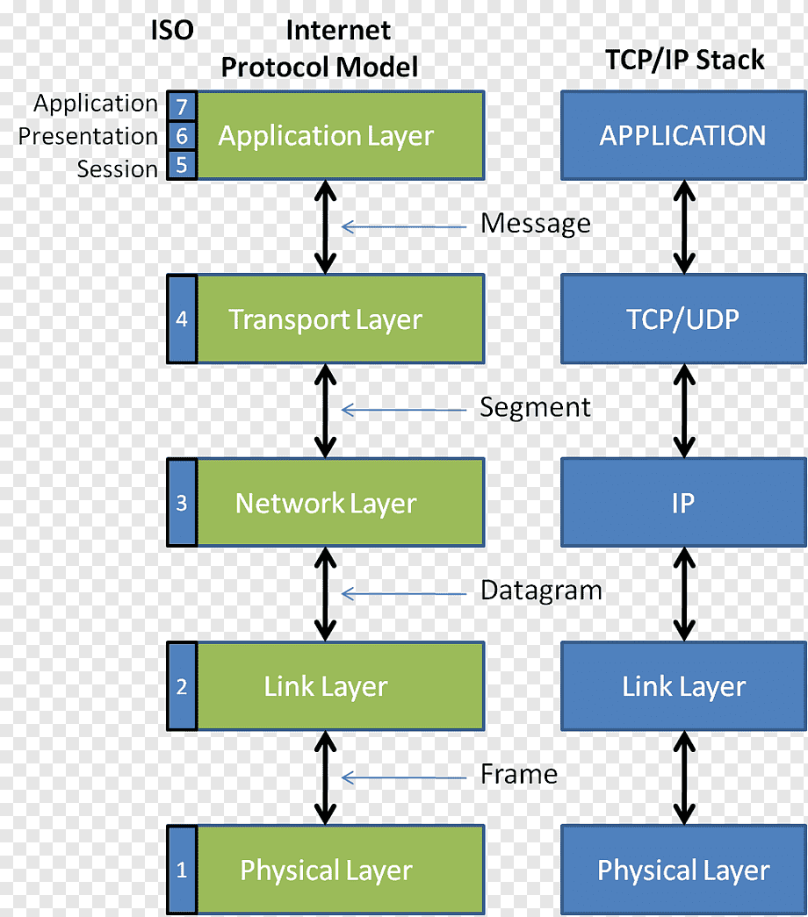
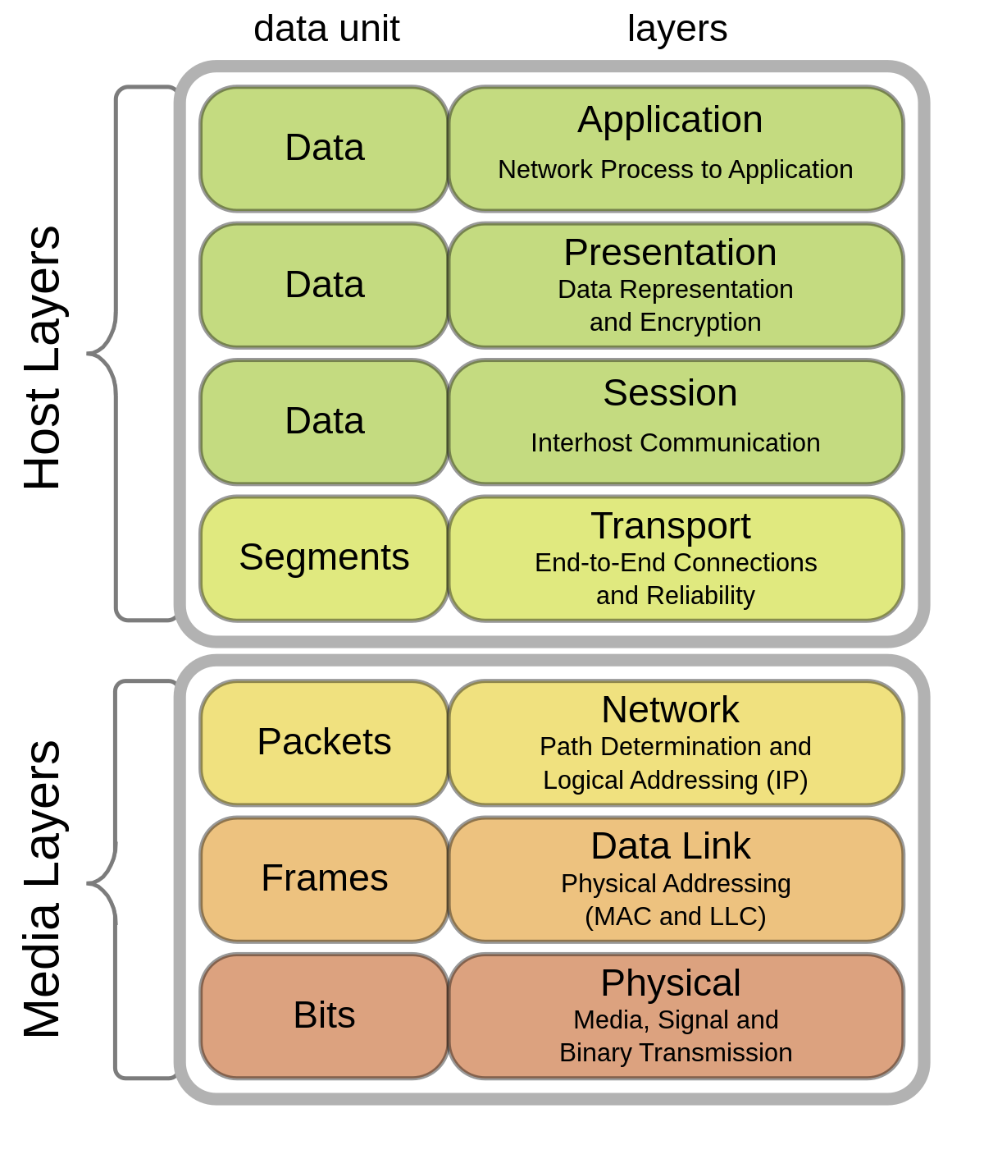
The Internet Protocol Stack Model
Layered Network Model (ISO/OSI)

Slide 5
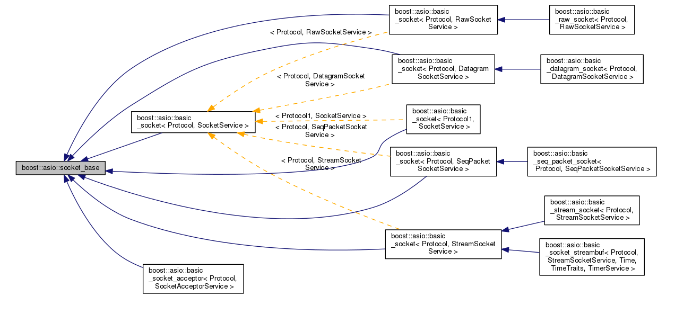
ASIO Model

Slide 6

FOR WHAT?

Slide 7

JG REBOOT

Slide 8

ASIO
Asynchronous programming model
Multi-threading support
Support of various protocols
Cross-platform
Ease of use
Wide user community

Slide 9
ASIO
The main components of asio are:
io_context is a class that manages asynchronous I/O operations. It provides a mechanism for queuing tasks and executing them asynchronously.
ip::tcp::socket is a class that represents a TCP socket. It is used to establish a connection with a remote host and exchange data.
ip::tcp::acceptor is a class that is used to listen for incoming connections on the server.
ip::udp::socket is a class that represents a UDP socket. It is used to send and receive datagrams.
ssl::stream is a class that represents a secure SSL connection. It is used to establish a secure connection and exchange data with a remote host.
https://github.com/memorisecodead/BeastExample/blob/main/Examples/ASIO/ASIOExample.hpp

Slide 10
BEAST
Ease of use
High performance
Multithreading support
Multi-protocol support
Cross-platform
Extensibility
Beast supports the following versions of the HTTP protocol:
HTTP/1.0
HTTP/1.1
HTTP/2

Slide 11
BEAST
Boost.Beast provides many methods and classes for working with network protocols in C++. Some of the most commonly used methods in Boost.Beast are:
http::request and http::response: classes for representing HTTP requests and responses, respectively.
http::write and http::read: functions for writing and reading HTTP requests and responses respectively.
http::async_write and http::async_read: asynchronous analogues of http::write and http::read.
websocket::stream: class for working with WebSocket protocol.
websocket::async_write and websocket::async_read: asynchronous methods for sending and reading messages through the WebSocket protocol.
ssl::context: class for configuring SSL/TLS connections.
ssl::stream: class for working with secured SSL/TLS connections.
tcp::socket: class for working with TCP sockets.
tcp::acceptor: class for listening for incoming connections on TCP socket.
streambuf: a class for buffering data input/output.
This is just a small list of methods and classes provided by Boost.Beast. The library also provides many other components that can be used for networking protocols in C++.
https://github.com/memorisecodead/BeastExample/tree/main/Examples/HTTPServer

Slide 12

Linking BEAST WITH ASIO
Beast at its core uses Asio to implement the asynchronous I/O needed to handle HTTP and WebSocket protocols. Asio provides mechanisms for asynchronous data reading and writing as well as for managing network connections.
Thanks to asio, it is possible to use SSL to make a secure HTTPS request.
Thus, Beast and Asio are closely related: Beast uses Asio to implement asynchronous I/O, and Asio provides the necessary functions and classes to handle asynchronous I/O in Beast. Using Asio allows Beast to provide high performance and efficiency with HTTP and WebSocket protocols.

Slide 13
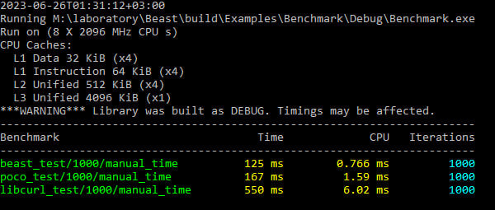
BEAST BENCHMARK AGAINST OTHER LIBS
For this benchmark, the following test code was written, which performs 1000 HTTP GET requests to Google and measures the average execution time of the request and the number of requests per second:
The benchmark was run on a machine with AMD Ryzen 5 3550h processor and Windows 22H2 operating system. The code was compiled with MSVC 14.32.31326.
Below are benchmark results comparing Beast, Poco, and Libcurl libraries for HTTP queries:
Lib versions:
boost/1.81.0 (beast/1.82.0)
poco/1.12.4
libcurl/8.1.2
https://github.com/memorisecodead/BeastExample/blob/main/Examples/Benchmark/main.cpp

Slide 14

Listener
The Listener class is a convenient class that wraps the tcp::acceptor object and handles incoming connections in a separate thread. It also manages the creation and removal of Session objects for each client. To create a server in Boost.Beast, you normally create a Listener object by passing it an io_context object, which is used to manage asynchronous I/O operations. You can then call the start() method of the Listener object, which will start listening to the port and handling incoming connections. When the server should be stopped, you can call the stop() method of the Listener object, which will stop listening to the port and terminate the server.
https://github.com/memorisecodead/BeastExample/blob/main/Examples/HTTPServer/Listener.hpp

Slide 15
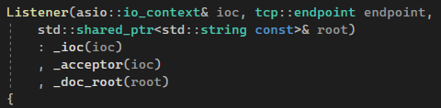
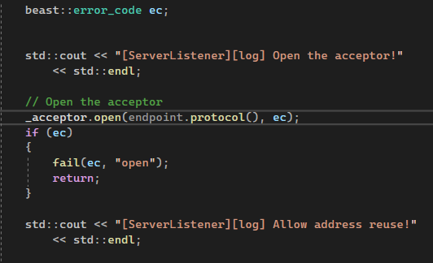
Listener
Constructor:
The constructor has checks for open acceptor, address resolution, server address configuration and server listening.
Check if the acceptor is open
acceptor::open(const protocol_type& protocol,boost::system::error_code& ec)
https://github.com/memorisecodead/BeastExample/blob/main/Examples/HTTPServer/Listener.hpp

Slide 16
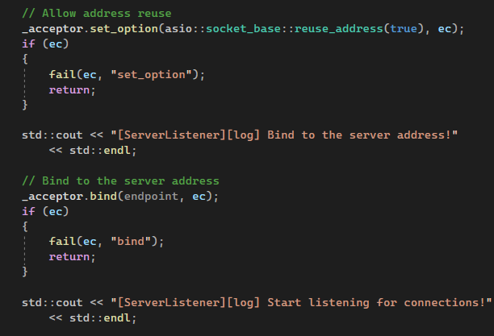
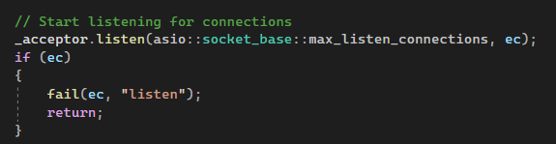
Listener
Check for address resolution. acceptor::set_option(const SettableSocketOption& option, boost::system::error_code& ec) - This function is used to set option on acceptor. option is the new option value to set on the acceptor.
acceptor::bind(const endpoint_type& endpoint, boost::system::error_code& ec) - Bind the acceptor to the given local endpoint. This function binds the socket acceptor to the specified endpoint on the local machine.
endpoint - an endpoint on the local machine to which the socket acceptor will be bound.
acceptor::listen(int backlog, boost::system::error_code& ec) - This function puts the socket acceptor into the state where it may accept new connections.

Slide 17
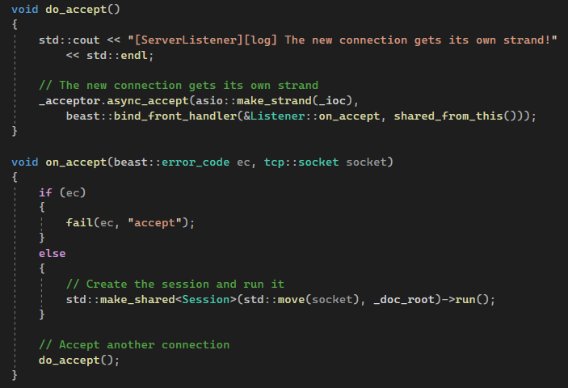
Listener
The Methods do_accept() and on_accept():
do_accept() method - this method takes a connection and forms its own connection.
on_accept(beast::error_code ec, tcp::socket socket) method - Create the session and run it. Inside the method there is a branching, if there is a bad acceptance, the fail(beast::error_code ec, std::string what) method will print an error message.
https://github.com/memorisecodead/BeastExample/blob/main/Examples/HTTPServer/Listener.hpp

Slide 18

Session
The Session class is used to manage the client connection lifecycle. It processes requests sent by the client and sends them responses. A Session object can be created for each client that connects to the server, and will be destroyed when the client connection is closed. Boost.Beast also has a tcp::socket class, which is used to communicate with the client. When the server accepts a new connection, it creates a new tcp::socket object for that connection and passes it to the Session object, which will use it to communicate with the client.
https://github.com/memorisecodead/BeastExample/blob/main/Examples/HTTPServer/Session.hpp

Slide 19
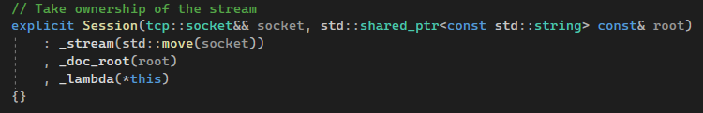
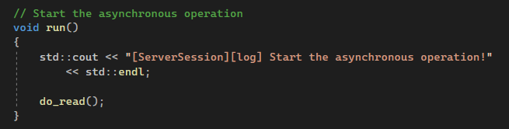
Session
Constructor:
run() method - method that starts asynchronous operations,
inside which is the do_read() method to start reading requests:
https://github.com/memorisecodead/BeastExample/blob/main/Examples/HTTPServer/Session.hpp

Slide 20
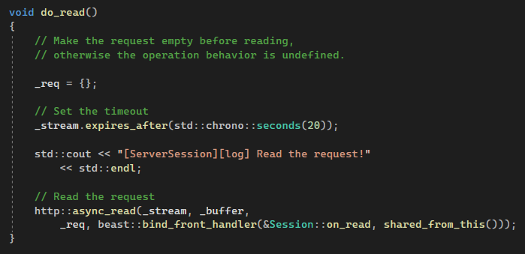
Session
do_read() method - A method for reading queries.
Reading is done via the http::async_read(_stream, _buffer, _req,
beast::bind_front_handler(&Session::on_read, shared_from_this()));
method, calling the subsequent on_read() method after reading:
https://github.com/memorisecodead/BeastExample/blob/main/Examples/HTTPServer/Session.hpp

Slide 21
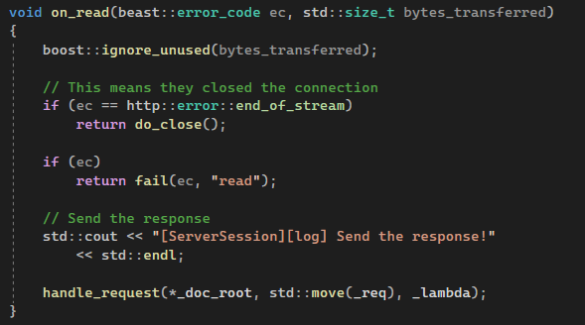
Session
on_read() method - method that processes the read request.
Before reading, a check is performed on the status of the request.
If the check succeeds, the handle_request() method handles the request,
checking internally that the request is correct.
After the check, it returns the result of the check:
https://github.com/memorisecodead/BeastExample/blob/main/Examples/HTTPServer/Session.hpp

Slide 22
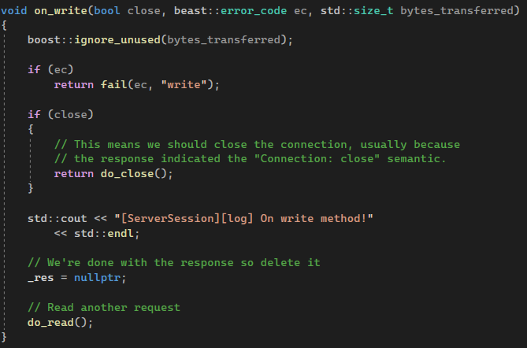
Session
on_write() method - The method of reading queries.
Contains internally a check on the state of the connection and badly processed request. After writing it reads the next request:
https://github.com/memorisecodead/BeastExample/blob/main/Examples/HTTPServer/Session.hpp

Slide 23
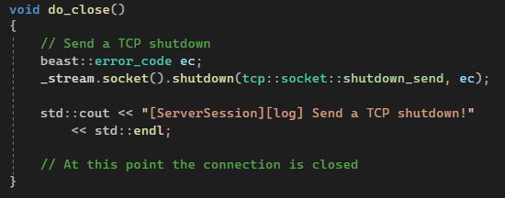
Session
do_close() method - TCP connection disconnect signal sending method:
tcp_stream calls the socket() method. The socket() method calls the shutdown method, taking enum tcp::socket::shutdown_send and beast::error_code ec.
https://github.com/memorisecodead/BeastExample/blob/main/Examples/HTTPServer/Session.hpp

Slide 24
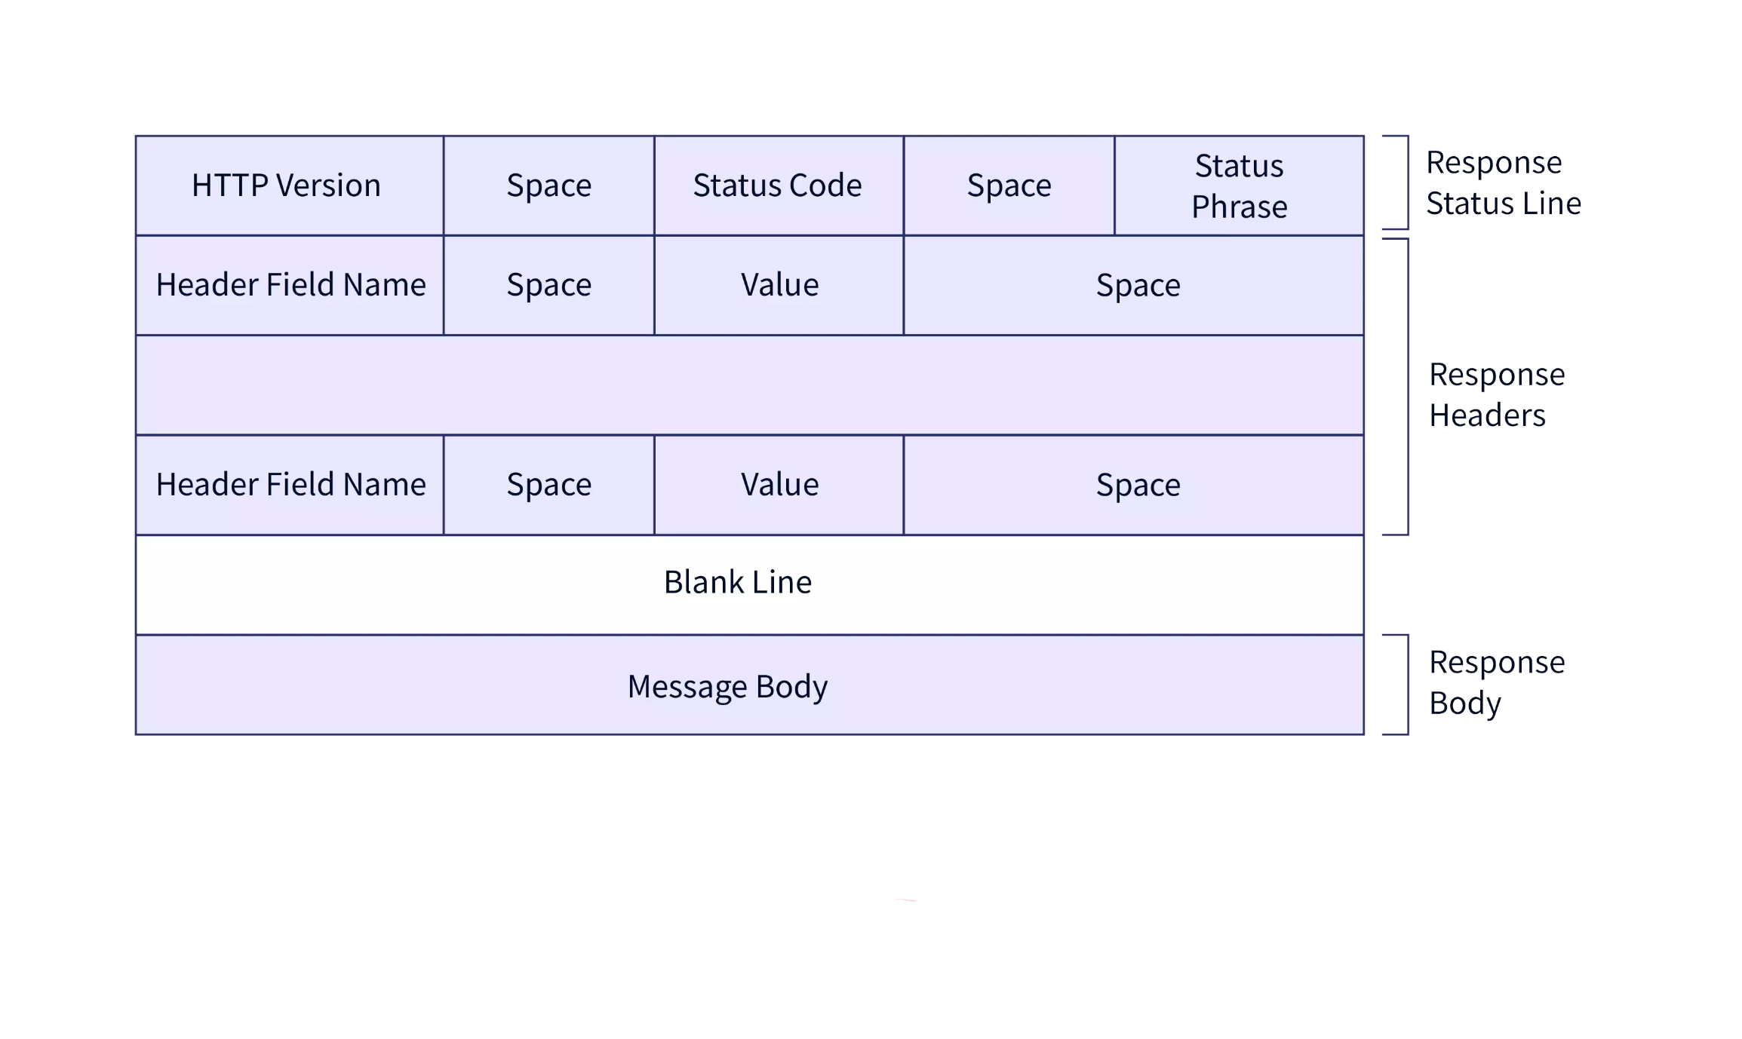
HTTP PROTOCOLS
HyperText Transfer Protocol is an application layer protocol used to
transfer data between a client and a server on the Internet.
There are several versions of the HTTP protocol:
HTTP/0.9
HTTP/1.0
HTTP/1.1
HTTP/2
HTTP/3
HTTP Construction

Slide 25
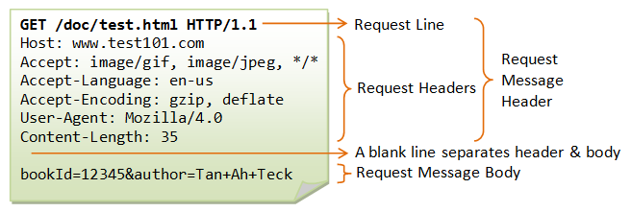
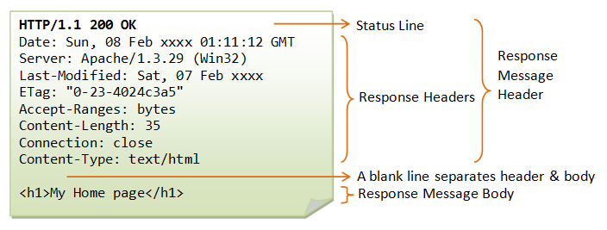
HTTP Request
HTTP Response

Slide 26
REST API
REST API (Representational State Transfer Application Programming Interface) is an architectural style used to create web services that exchange data with clients over HTTP.
The REST API is used to exchange data between client and server applications using the HTTP protocol.
The REST API relies on the use of standard HTTP methods such as GET, POST, PUT and DELETE to perform operations on resources.
In the REST API, each resource is represented by a unique URL, and client applications can send requests to that address to access the resource.
The REST API uses data formats, such as JSON or XML, to represent resources and transfer data between the client and the server.
The REST API is used in many applications, such as social networks, messengers, online stores, and others, and allows you to create flexible and scalable web services that can exchange data with client applications on different platforms and devices.

Slide 27
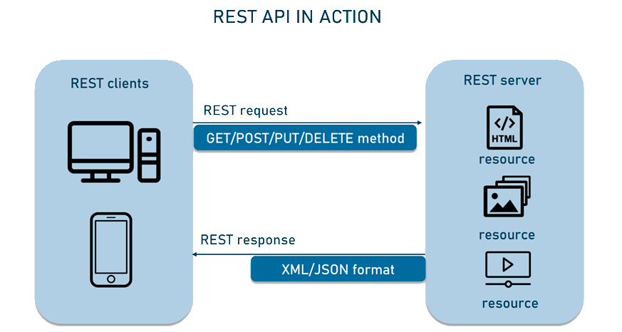
REST API

Slide 28
HTTP PROTOCOLS EXAMPLE
http::request<http::string_body> req{verb, target, version}; - creating a request with a specific verb, target, and http protocol version
req.set() - is used to set the HTTP header value. It has three overloads:
req.set(http::field::host, _host); - The first overload takes the header name as string_view and the header value as string_view. This method replaces any existing header value with the new value specified in value.
req.set(http::field::user_agent, BOOST_BEAST_VERSION_STRING); - The second overload takes a field object, which represents an HTTP header. This method replaces any existing header value with the new value specified in the field object.
req.set(http::field::content_type, "application/x-www-form-urlencoded"); - The third overload takes a field object, which represents the HTTP header, and the header value specified as string_view. This method replaces any existing header value with the new value specified in value.
https://github.com/memorisecodead/BeastExample/blob/main/Examples/HTTPRequests/HTTPExample.hpp

Slide 29
HTTP PROTOCOLS EXAMPLE
http::response is an HTTP response class that is used to send content to the client. It can be parameterized with different response body types, such as http::string_body, http::file_body, http::buffer_body and others.
The http::response class has many methods to set response properties, such as HTTP version, response status, headers, response body and others. For example, to set response status and "Content-Type" header, you can use the following code:
http::response<http::string_body> res;
res.version(version);
res.result(status);
res.set(http::field::server, BOOST_BEAST_VERSION_STRING);
res.set(http::field::content_type, "text/html");
https://github.com/memorisecodead/BeastExample/blob/main/Examples/HTTPRequests/HTTPExample.hpp

Slide 30
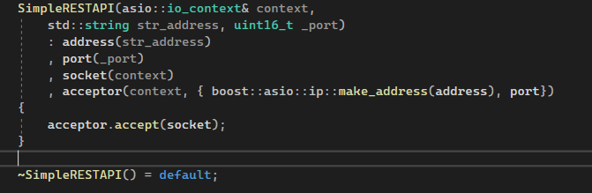
REST API EXAMPLE
Here's an example of using Boost.Beast to create a simple REST API:
Constructor & destructor:
Creating an io_context object, which is used to manage asynchronous I/O operations. Then an acceptor object is created that listens on a given port. For each incoming connection a socket object is created and a connection is accepted using the accept() method.
https://github.com/memorisecodead/BeastExample/blob/main/Examples/RESTAPI/SimpleRESTAPI.hpp

Slide 31
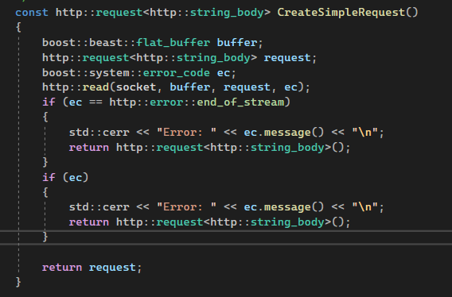
REST API EXAMPLE
The method of creating a request:
Uses boost::beast::flat_buffer to read request from socket and http::request object to parse request. After reading, using the http::read(socket, buffer, request, ec) method, we read the server's response after sending the request. This method reads the contents of the HTTP response and returns it as a string or object. If the request is successfully parsed, a response is created using the http::response object.
https://github.com/memorisecodead/BeastExample/blob/main/Examples/RESTAPI/SimpleRESTAPI.hpp

Slide 32
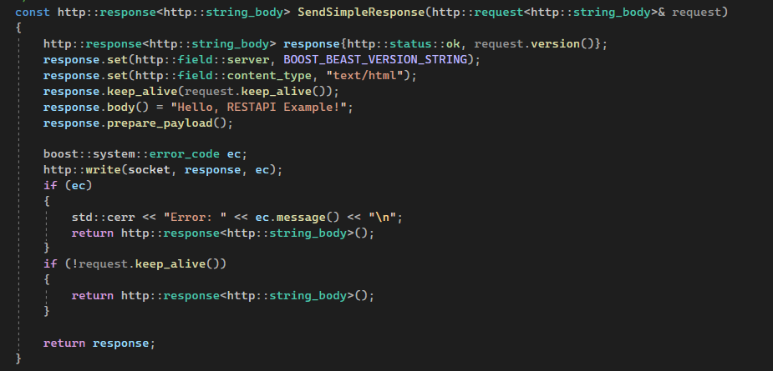
REST API EXAMPLE
The method of sending a response to a request:
If the request is successfully parsed, a response is created using the http::response object. In this example, we set the response status to http::status::ok, the Server header to the current version of Boost.Beast, and the content type to text/html. We also set the keep-alive flag for the response to maintain a persistent connection. We then set the body of the response to "Hello, RESTAPI Example!" and prepare it for sending using the prepare_payload() method. We send the response to the client using the http::write() method.
If the request was not marked as keep-alive, we exit and terminate the server.
https://github.com/memorisecodead/BeastExample/blob/main/Examples/RESTAPI/SimpleRESTAPI.hpp

Slide 33
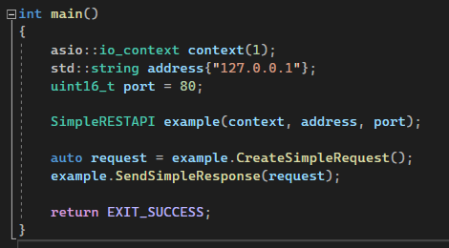
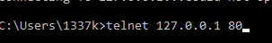
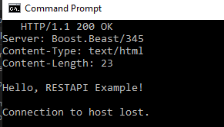
REST API EXAMPLE
Main foo:
Client role: telnet
Once started, the server will listen on port 8080 and respond to HTTP requests with a status of 200 OK and the response body "Hello, RESTAPI Example!".
https://github.com/memorisecodead/BeastExample/blob/main/Examples/RESTAPI/SimpleRESTAPI.hpp

Slide 34

CONCLUSION

Slide 35



REFERENCES

